Slide 1
The Global Biodiversity Information Facility (GBIF), strengths and weaknesses in Africa
Professor Jean Cossi GANGLO
Faculty of Agricultural Sciences
University of Abomey-Calavi
Benin

Slide 2
Outline of the presentation
Introduction
Global Biodiversity Information Facility (GBIF), a mega infrastructure to support Biodiversity Informatics (BI)
Background and history
Overview of the database
The network
Global Biodiversity Information Facility (GBIF) in Africa (GBIF-Africa)
Strengths
Weaknesses
Concluding remarks and the way forwards

Slide 3
Introduction
Context and justification
Biodiversity is of utmost importance to the survival of humanity
Provisioning ecosystem services include products obtained from ecosystems such as food, crops, raw materials at the global scale, the forest stock in wood is estimated at 557 billion cubic meters and 76 billion at the scale of Africa(FAO, 2020a).
Regulating ecosystem services in mitigating the effect of climate change. Globally, the carbon storage in aboveground and belowground forest biomass is 662 Gt and 81 Gt at the scale of Africa (FAO, 2020a)

Slide 4
Introduction
Context and justification
Biodiversity is of utmost importance to the survival of humanity
Cultural ecosystem services through spiritual enrichment, recreation, ecotourism, and aesthetic experiences (IPBES, 2018, FAO, 2020a)
Supporting services that are necessary for the production of all other ecosystem services (primary production, nutrient and water cycles, soil protection, seed dispersal etc. (IPBES, 2018, FAO, 2020a).

Slide 5
Introduction
Context and justification
Despite its utmost importance, biodiversity is submitted to threats :
Habitat degradation
The rate of net forest loss declined is 4.7 million ha per year in 2010–2020 (FAO, 2020a).
Ecosystem overexploitation is still well spread across regions (example of a nearly five-fold increase in global marine fish catch has left many fisheries overexploited (FAO, 2020b)

Slide 6
Introduction
Context and justification
Despite its utmost importance, biodiversity is submitted to threats of :
invasive alien species:
the annual environmental losses caused by introduced pests in the United States, United Kingdom, Australia, South Africa, India, and Brazil have been calculated at over US$ 100 billion;
Native to the Amazon basin, water hyacinth (Eichhornia crassipes) has invaded tropical habitats worldwide spreading to more than 50 countries on five continents.
Water hyacinth blocks waterways, decimates aquatic wildlife and the livelihoods of local people and creates ideal conditions for disease and its vectors)

Slide 7
Introduction
Context and justification
Despite its utmost importance, biodiversity is submitted to threats of :
climate change:
Warming trends in temperature and climate related extremes such as heat waves, droughts, floods, cyclones, and wildfires are being observed at global scale and across regions (Boko et al., 2007; IPCC, 2020).

Slide 8
Introduction
Context and justification
Despite its utmost importance, biodiversity is submitted to threats of :
Pollution (use of biocides, industrial farming practices affecting soil fertility, soil acidification, disruption of aquatic life by fertilizers, oil spills) (Dumas, 2002; Riedacker, 2004; Riera et Alexandre, 2004; FAO, 2020) causes a huge loss of biodiversity
Diseases affecting animals, plants, and people

Slide 9
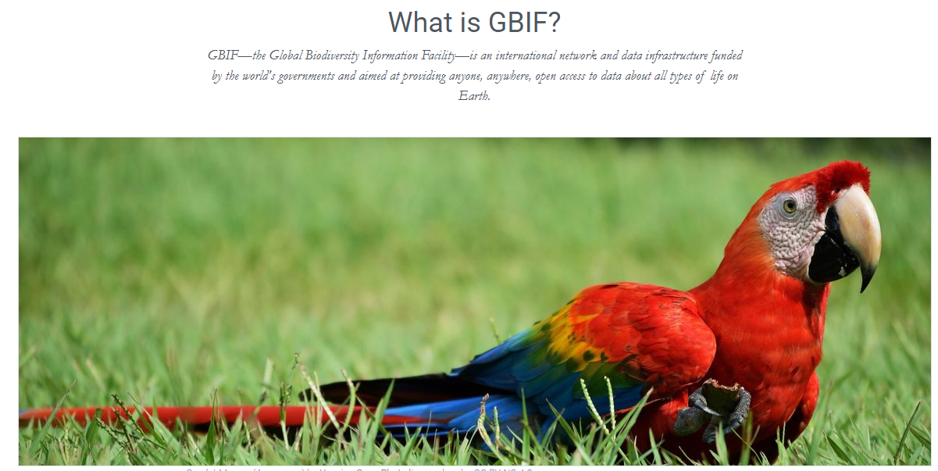
Global Biodiversity Information Facility (GBIF), a mega data infrastructure
GBIF—the Global Biodiversity Information Facility—is an international network and data infrastructure funded by the world's governments and aimed at providing anyone, anywhere, open access to data about all types of life on Earth.

Slide 10
Global Biodiversity Information Facility, a mega infrastructure
Background and history
GBIF arose from a 1999 recommendation by the Biodiversity Informatics Subgroup of the Organization for Economic Cooperation and Development (OECD)’s Megascience Forum.
That recommendation was endorsed by OECD science ministers and, in 2001, GBIF was officially established through Memorandum of Understanding between participating governments.

Slide 11
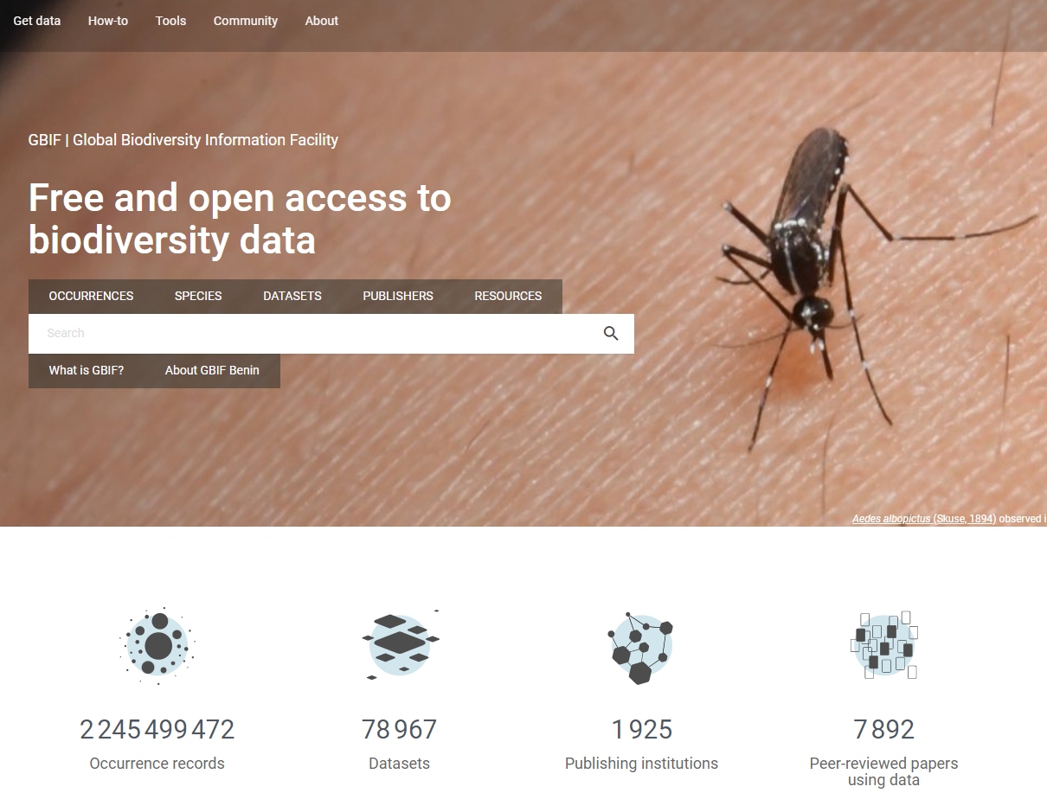
Global Biodiversity Information Facility, a mega infrastructure Overview of the database

Slide 12
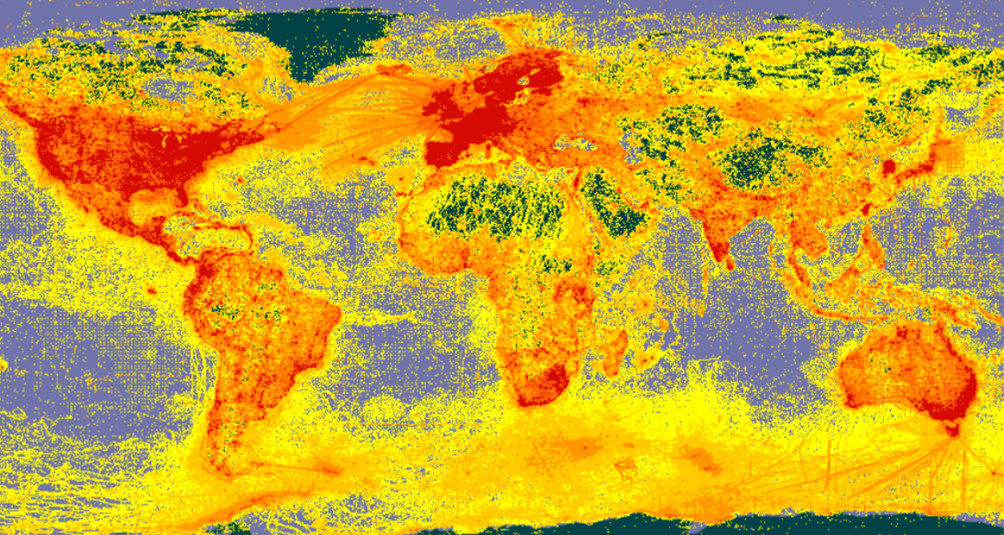
Global Biodiversity Information Facility, a mega infrastructure
GBIF Data in geographic space

Slide 13
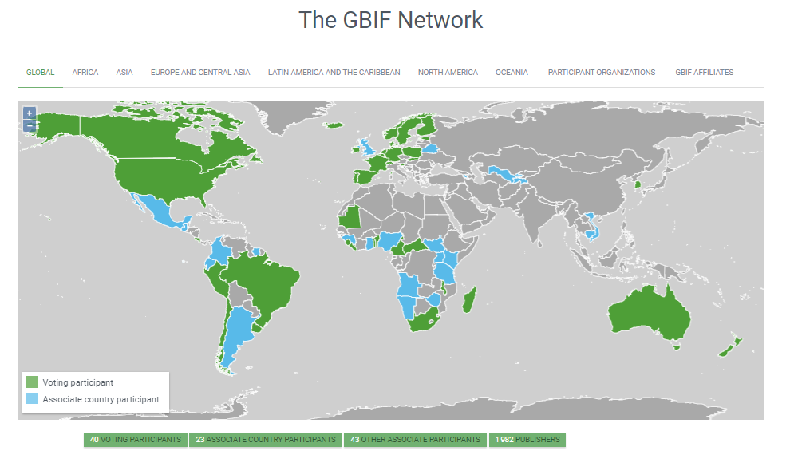
Global Biodiversity Information Facility, a mega infrastructure to support Biodiversity Informatics

Slide 14
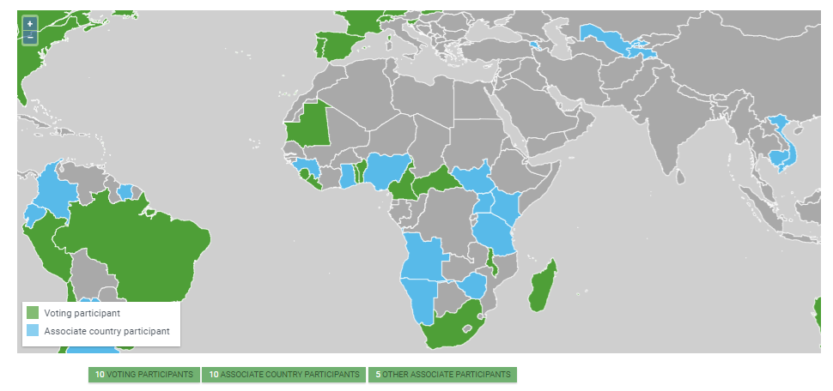
Global Biodiversity Information Facility in Africa (GBIF-Africa): Strenghts
Regional representative:Prof. Jean GANGLO (Benin)
Deputy regional representative: Innocent Akampura (Uganda)

Slide 15
Global Biodiversity Information Facility in Africa (GBIF-Africa): Weaknesses
Africa accounts for less than 1.5% of GBIF data with
large disparities between countries
Figure 1: Ten top countries publishing data on GBIF site (www.gbif.org)

Slide 16
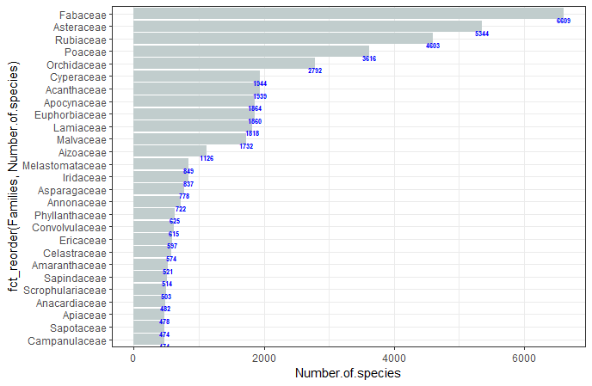
Global Biodiversity Information Facility in Africa (GBIF-Africa): Weaknesses
Out of the 72,991 plant species (derived from 723 plant families) published on the GBIF site, 15 families shared more than 50% of the species (Figure 2).
https://www.researchsquare.com/article9/rs-2187785/v1
Figure 2: Species richness pattern across plant families

Slide 17
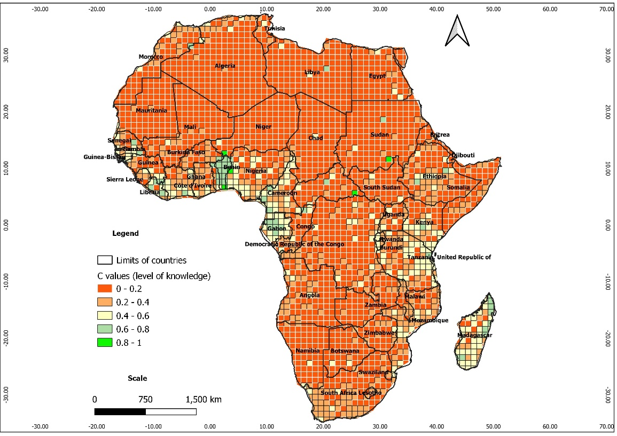
Global Biodiversity Information Facility in Africa (GBIF-Africa): Weaknesses
https://www.researchsquare.com/article9/rs-2187785/v1
Figure 3: Geographic patterns of inventory
completeness across Africa at 01° spatial resolution

Slide 18
Concluding remarks and the way forwards
New data collections to fill data gaps across plant taxonomic groups should address the representativeness of plant families. For example, the Meliaceae, Ebenaceae, and Moraceae families are rich in many valuable timber plant species; the Lamiaceae, Combretaceae, Sapotaceae, and Anonaceae families contain many medicinal plants and/or bear fruits of commercial interest. They should also be among the priorities for new data collections across Africa

Slide 19
Concluding remarks and the way forwards
It appeared that in the different sub-regions of Africa, efforts are still needed across countries to fill data gaps
In order to account for problems of accessibility, priorities of new data collections must address remote areas from roads and waterways (beyond 500 – 2000 m) (Kadmon et al., 2004) as well as remote areas of largest protected areas (> 2500 km²).
Opening of new roads, with more representativeness of ecological conditions of the landscapes across African countries, can significantly contribute to less biased data collections.

Slide 20
Concluding remarks and the way forwards
Africa is suffering from lack of infrastructure, connectivity, and academic skills to use professionally data to inform decisions.
With respect to lack of academic skills, its is important to encourage and support academic training ongoing on the continent and capacity building initiatives as well
Case of the master and Ph. D programs in biodiversity informatics at the Faculty of Agricultural Sciences of the University of Abomey-Calavi
Contact: ganglocj@gmail.com ; phone 00229 94578915; Whatsapp: 00229 66363770

Slide 21
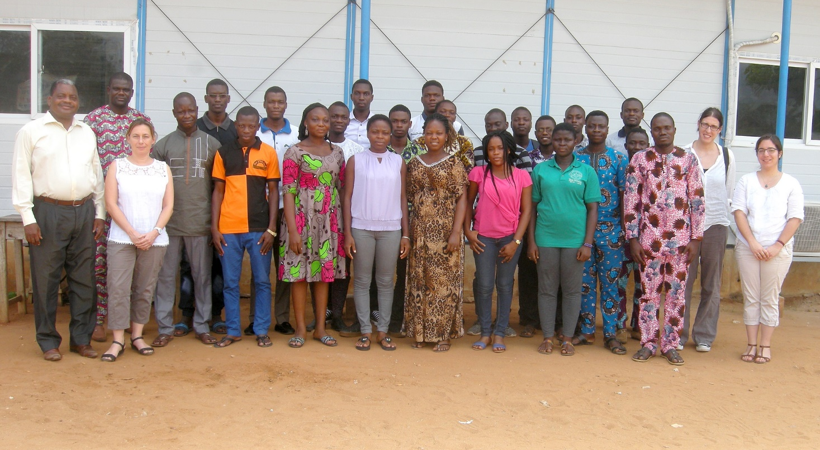
MANY THANKS FOR YOUR ATTENTION
First cohort of the master students in biodiversity informatics at the University of Abomey-Calavi (2017-2018)

